Slide 1

Capstone project
On Hotel Booking
Prepared by :Mani Raj

Slide 2
Introduction
This data set contains booking information for a city hotel and a resort hotel.
Includes information such as when the booking was made, length of stay, the number of adults, children, and/or babies.
The number of available parking spaces, among other things.
e number of available parking spaces, among other things.

Slide 3
Data Summary
Data Set Name
Hotel Booking Database including booking information for a city hotel and a resort hotel of various countries from 2015 – 2017.
Row-119390
Column-32
Shape

Slide 4
Column Used
Hotel - H1 city hotel, H2 Resort hotel
is_canceled - 1:Canceled, 0:Not canceled
Lead_time - Time between booking & arrival
Arrival_date_year - year of arrival date
Arrival_date_month - month of arrival date
Arrival_date_week_number – Week number of year for arrival date
Arrival_date_day_of_month – Day of arrival date
Stays_in_weekend_nights – stay in weekend nights

Slide 5
Stays_in_week_nights - stays in week nights
adults – total number of adults in hotel
Children – total number of children in hotel
babies – total number of babies in hotel
Meal – Bed & Breakfast (BB), Half Board (HB), Full Board (FB), Undefined contain no meal package
Country – country of customers
Market segment – A group of people who share one or more common characteristics used for business
distribution_channel –Chain of business through which a service passes until it reaches the final buyer

Slide 6
Previous_cancellations – previous cancellation by customer
Previous_booking_not_canceled- confirmed booked by customer
reserved_room_type – Pre-booked by customers
assigned_room_type – single / couple / family
booking_charges – booking charges we charged
deposit_type – No Deposit, Non Refund, Refundable
agent- ID of travel agency
company- ID of the company
days_in_waiting_list – Number of days in waiting

Slide 7
The Past 5 Years
High demand from leisure and business travelers and international tourists Revenue growth at average annual rate of 4.2% Demand for hotel rooms has outpaced supply, leading to higher room rates IBIS predicts strong growth in extended-stay hotels, boutique hotels, spa and health retreats and resorts. The industry has grown rapidly Increases in travel spending, corporate profit and consumer spending this lets suppliers charge more and operate with lower vacancy

Slide 8
Problem Statements
Have you ever wondered when the best time of year to book a hotel room is? Or the optimal length of stay in order to get the best daily rate?
What if you wanted to predict whether or not a hotel was likely to receive a disproportionately high number of special requests?
This hotel booking dataset can help you explore those questions!

Slide 9
Table of contents
Cancellation status
Special Requests
Booking ratio between Resort & City hotel
Number of people who booked the hotel
Country origin of most guests
Booking per year
Busiest month for hotels
Meal Type

Slide 10
Number of Travellers in various month
Room Type
Repeated Guest
Reservation Status
Weekends v/s Weekdays
Checking Travellers
Booking
Satisfactory of Customers
Challenges
Conclusion

Slide 11
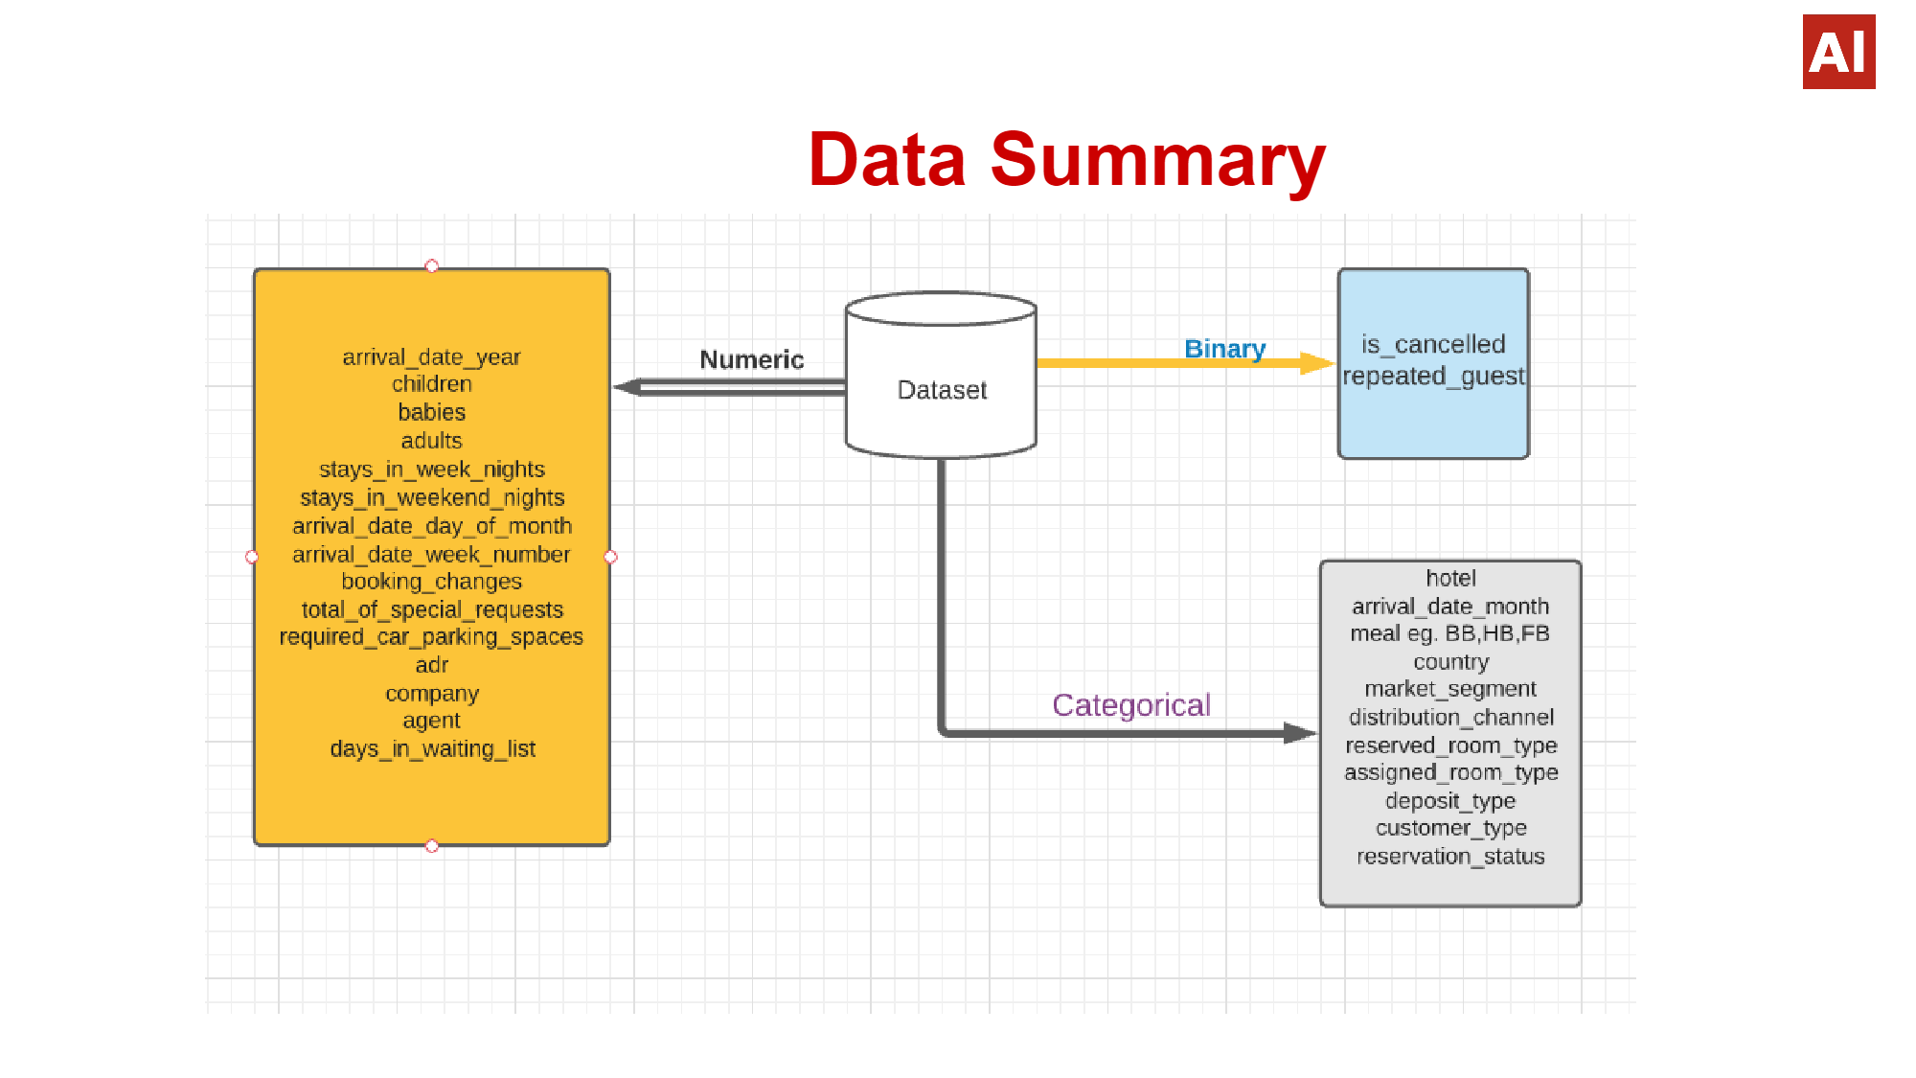

Slide 12
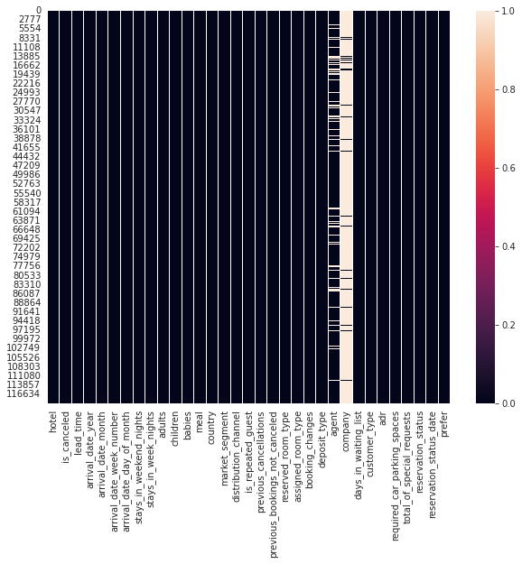
Finding Null value using Heatmap

Slide 13
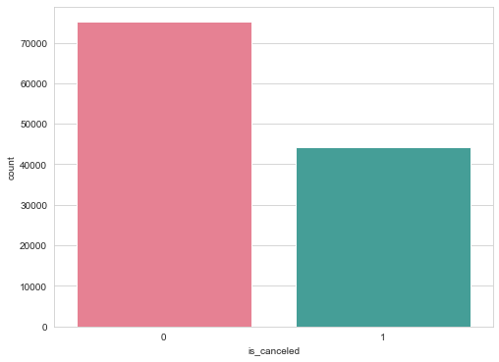
How Many Booking Were Cancelled
● During the year we have 37% of cancelations.

Slide 14
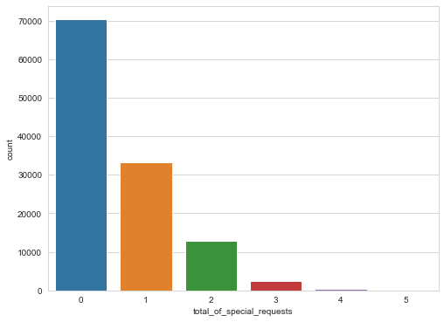
Special requests
● As we can see here among all one special booking request were made almost 27% of total bookings.
● Two special request were made nearly 10% among all and 3 special request is nearly 2%.

Slide 15
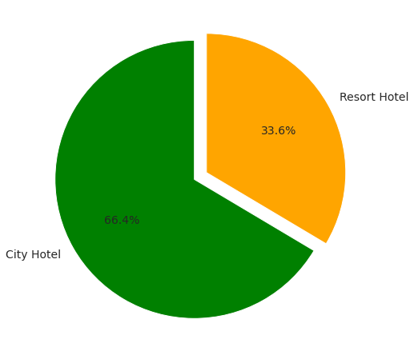
Booking ratio between Resort & City hotel
What do we see here?
● It seems that a huge proportion of hotels was city hotel.
● Resort hotel tend to be on the expensive side and most people will just
stick with city hotel. Also, resort hotels tend to be appropriate for larger group of people.

Slide 16
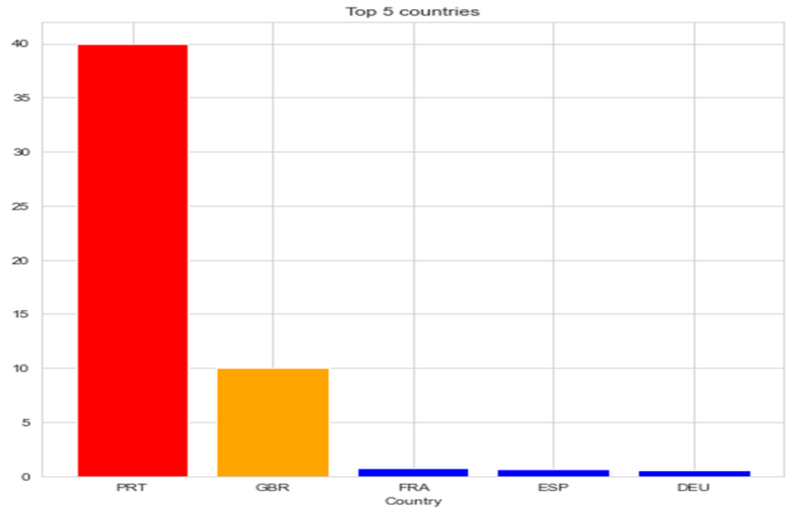
Country origin of most guests
● As we can see, Portugal tops the list with 40.69% of the guests.
● The European countries tops the table, seems like they are more interested in traveling as compare to others country.

Slide 17
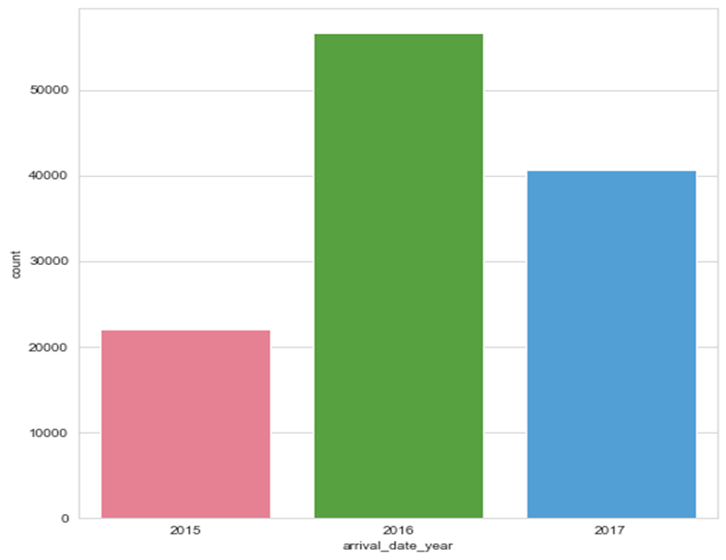
Booking per year
● There has been many arrivals in the year 2016 than the remaining years.
● We can also say that there has been increase in the arrivals as years passes.

Slide 18
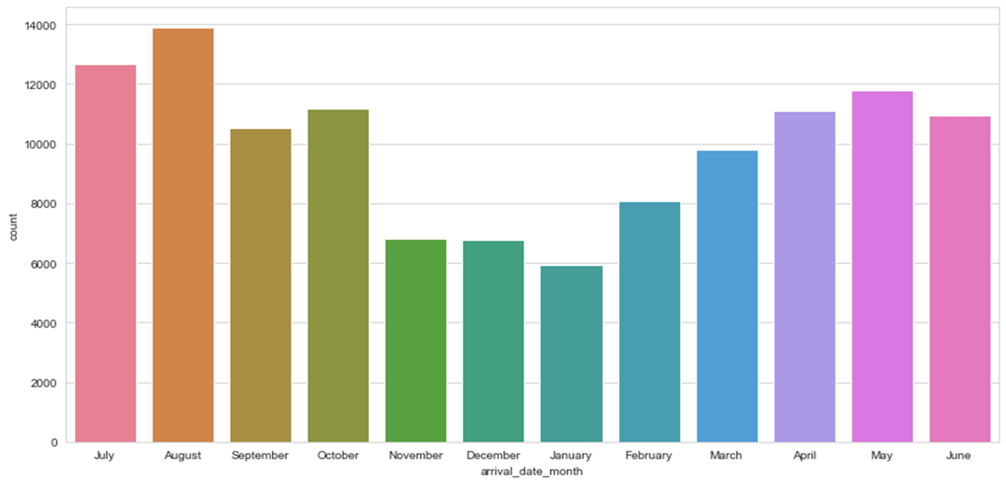
Busiest month for hotels
● The Busiest month for hotel is August with 11.62% of the reservations.
● The month of least occupation is January with 4.96% of the reservations.

Slide 19
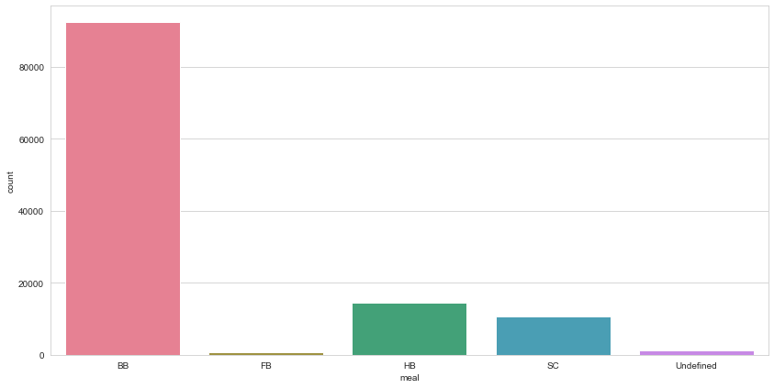
Meal Type
● The most eaten meal is BB with the count 80000.
● The least eaten meal is FB with count below 100.

Slide 20

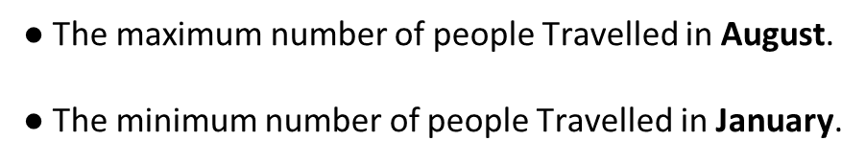
Number of Travellers in Various Months
January
December
November
February
March
September
June
April
October
May
July
August

Slide 21
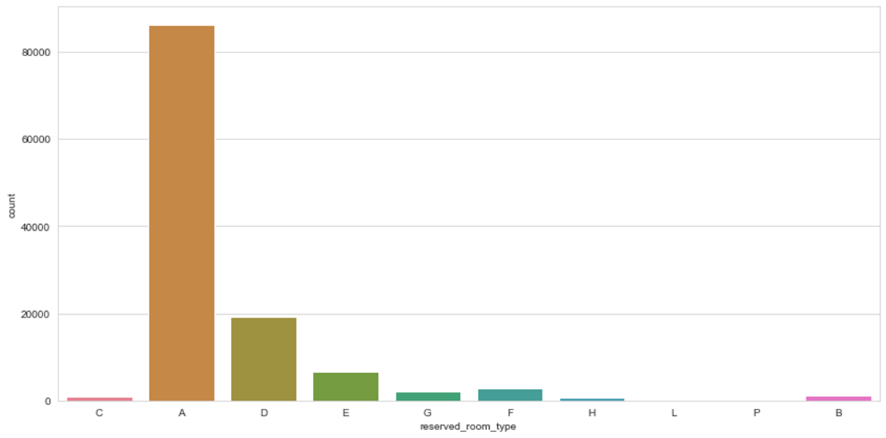
Room Type
● The Room Type “A” is selected by people almost every time.

Slide 22
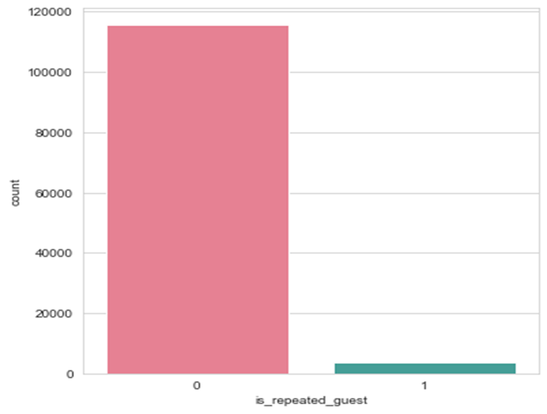
Repeated Guest
● The Repetition of a particular guest is seems to be very rare.

Slide 23
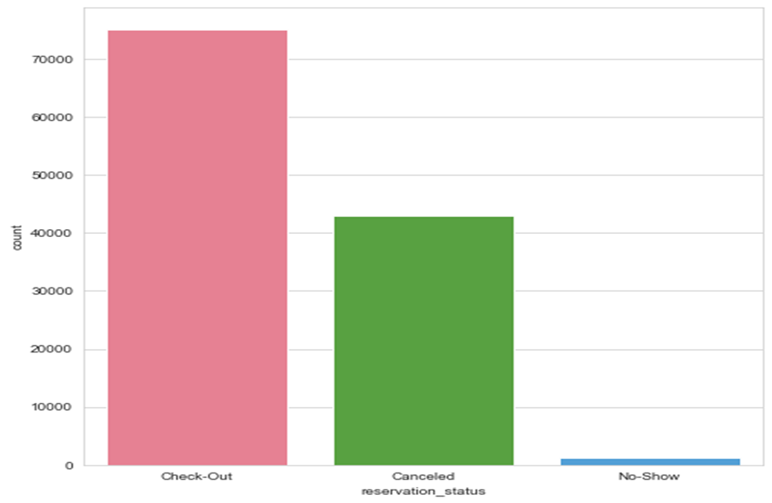
Reservation Status

Slide 24
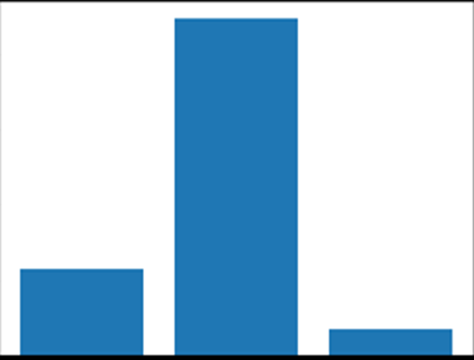
Room Types
80000
60000
40000
20000
0
single
couple
family
● Clearly Majority of the rooms booked are couple rooms.

Slide 25
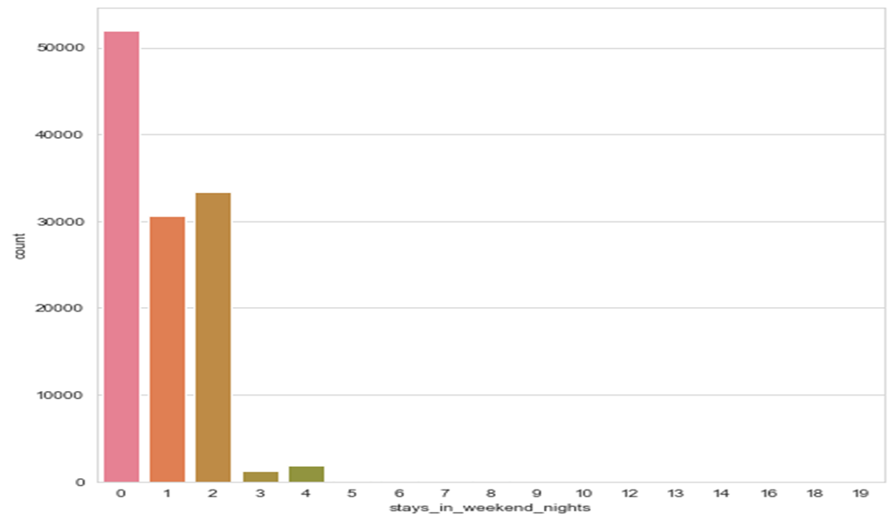
Average stays on weekends
● PEOPLE GENERALLY PREFER LONG STAYS ON WEEKDAYS RATHER THAN WEEKENDS.
● The count for booking on weekdays is higher than that of weekends with more than 50000.

Slide 26
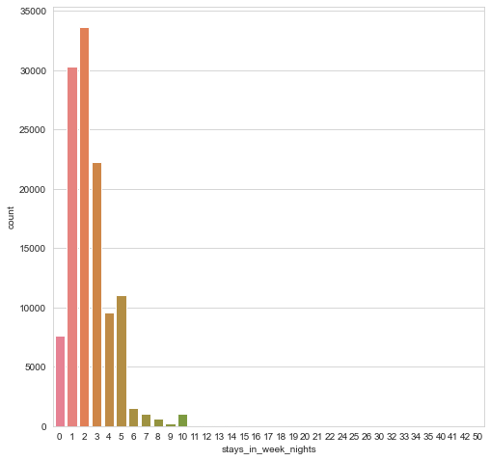
Average stays on Weekdays
● People in weekdays prefer to stay for 1-3 days.
● People stays on weekdays is more than that of weekends.

Slide 27
Checking the travelers without babies
Number of babies | Number of bookings
0 | 118473
1 | 900
2 | 15
10 | 1
9 | 1
There are around 118,473 rooms booked without baby.
There are around 917 rooms booked with one or more than one babies.

Slide 28
Checking the adult traveler count
Number of adults | Number of bookings
2 | 89680
1 | 23027
3 | 6202
4 | 62
26 | 5
10 | 1
6 | 1
● There are around 89,680 room booked as couple room
● There are around 23027 room booked as single room

Slide 29

Booking
50000
40000
30000
20000
10000
0
Online Booking
Offline Booking
● Majority of the customers book through online rather than offline booking

Slide 30

Satisfactory of customers
80000
60000
40000
20000
10000
0
Satisfied
Change of Room
● Majority of the customers has got the room type they have booked

Slide 31
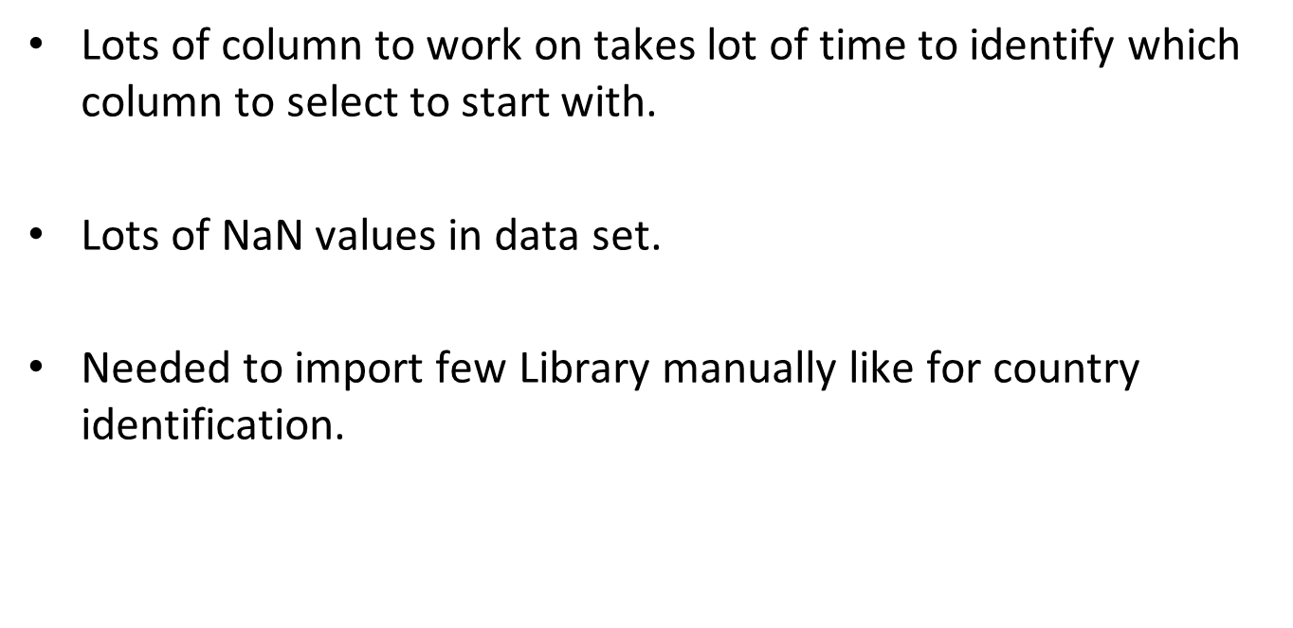
Challenges

Slide 32
Conclusion
Majority of the hotels booked are city hotel. Definitely need to spend the most targeting fund on those hotel.
We also realize that the high rate of cancellations can be due high no deposit policies.
We should also target months between May to Aug. Those are peak months due to the summer period.
Majority of the guests are from Western Europe. We should spend a significant amount of our budget on those area.
Given that we do not have repeated guests, we should target our advertisement on guests to increase returning guests.

Slide 33

THANK YOU

